Slide 1



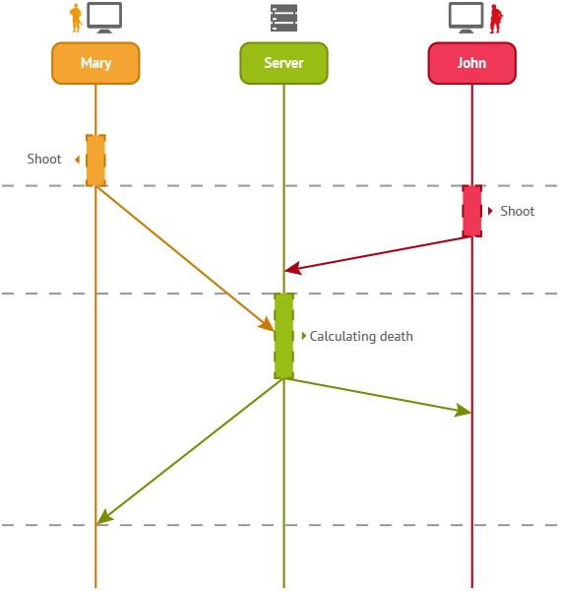
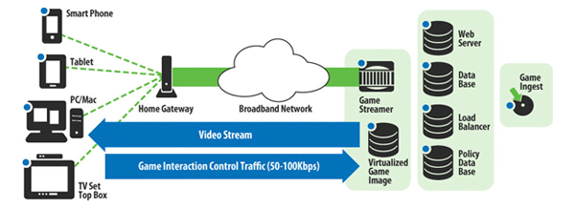
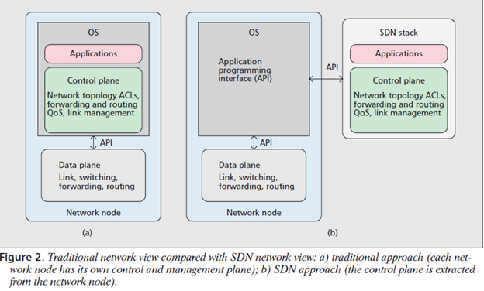
Other Related Logos
School of Computing & Information Sciences
IDS 5993, 2017, SPRING
Next Generation Networking for Virtual Reality and Game Player Collaborative and Multi-Player 1.0
Student: Gabriel Taveras, Florida International University
Mentor: Dr. Francisco Ortega, Florida International University
Instructor: Masoud Sadjadi, Florida International University
Problem
With next-generation video games on the rise, the demand of online gaming content has dramatically increased. The new generation of gamers desire instant gratification of low latency and high throughput force on force multiplayer action, with little to no network delay (lag) or downtime.
Solution
The implementation of Software-Defined Networking (SDN) within the video game industry provides a great ordeal for game servers to dynamically handle varying amounts of network traffic and bandwidth, to provide a smoother gaming experience, without users worrying about their Internet speed.
Current System
Screenshots
Requirements
The SDN Architecture will require extensive work and research to ensure compatibility with existing network paradigms. SDN must also be supportive to all types of networks, including:
Wide Area Transport Networks
Data center networks
Residential IP services
Intra-site service
Transport Services
System Design
Implementation
Incorporate SDN capabilities by reducing amount of hardware specifications, which will require more maintenance services, and allowing more controllable software API and virtualized framework to manage workflow of constant streaming of data packets, to reduce payload of physical servers.
A hypernet is an integrated bundle that covers all the knowledge needed to create a SDN network and deploy the software needed to run on the SDN. It can be tailored for a specific game would contain a program to devise the optimal network topology from:
- given set of current players
- the software protocol stacks utilized on the end system
-router methods(priority queues, multicast, routing tables)
Verification
We want to provide a foundational support for future implementation for multiplayer collaboration. In future projects, we aim to test SDN on higher end gaming platforms to test, and improve network efficiency in an online environment.
Object Design
Summary
SDN provides the solution for reduced latency and improve online performance across video game network infrastructure. For future works, we would like to expand about Virtual and Augmented Reality platforms; which will require more extensive hardware and network support.
We convey a “hypernet” as the underlying framework supporting specific set of APIs
User would be able configure/program each switch and allow communication between each API to run on each switch; rather than application pre-configured on switch.
Acknowledgement
The material presented in this poster is based upon the work supported by Gabriel Taveras and Bradley Marzouka. I am thankful to the help that I received from my group members, FIU faculty, and professional colleagues. A big thank you to Dr. Francisco Ortega and Mohsen Taheri of FIU’s SCIS for their support to conduct this research and to my professional colleague Aarti Ragoonath, whom I cannot greatly appreciate the insight and abetment.
Notes:
1

